Slide 1
AZ-900T01 Module 01: Cloud concepts

Slide 2
Lesson 01: Learning objectives

Slide 3
Module 1 – Learning objectives
Describe and understand :
cloud services and their benefits.
key cloud service terms.
Public, Private, and Hybrid cloud models.
Infrastructure as a Service (IaaS).
Platform as a Service (PaaS).
Software as a Service (SaaS).

Slide 4
Lesson 02: Why cloud services?

Slide 5
Video: Cloud Services

Slide 6
Key concepts and terms
Cloud services characteristics and considerations:
High availability | Disaster recovery
Scalability | Global reach
Elasticity | Customer latency capabilities
Agility | Predictive cost considerations
Fault tolerance | Security
Notes:
Please describe each characteristic.
For more conceptual detail about cloud computing, see https://azure.microsoft.com/en-us/overview/what-is-cloud-computing/
A term reference guide is available at https://azure.microsoft.com/en-us/overview/cloud-computing-dictionary/

Slide 7
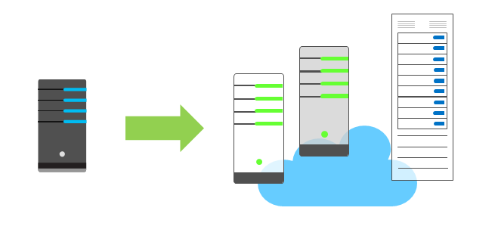
Economies of scale
The ability to operate less expensively and more efficiently at larger scale.
Large cloud providers (Microsoft, Google, Amazon Web Services, etc.) leverage benefits of economies of scale, and pass benefits to their customers.
Notes:
Example end user benefits of economies of scale:
Large-scale operators get discounts on bulk purchases of expensive hardware, which allows many customers to use the hardware at reduced costs.
Storage costs have decreased in the last decade. This enables cloud providers to purchase large volumes of storage, at significant discounts. By using the storage efficiently, cloud providers can pass the reduced cost benefits on to their end users.
The benefits of economies of scale to large organizations are limited.
High demand for a product lowers (mass) production costs, which reduces the costs passed on to end users.
If product demand decreases, keeping prices low for end users may not cover the costs of production.
Increased competition also effects the costs of cloud services.

Slide 8
CapEx vs. OpEx
Capital Expenditure (CapEx) : spend on physical infrastructure up front, deduct the expense from your tax bill.
High upfront cost, value of investment reduces over time.
Operational Expenditure (OpEx) : spend on services or products as needed, and get billed immediately. Deduct the expense from your tax bill in the same year.
No upfront cost, pay-as-you use.
Notes:
Today, organizations can sign up with a cloud provider to get up and running easily. Organizations can begin selling products or providing services to customers quickly, and without incurring high upfront costs.
OpEx : If your service is busy and consumes many resources each month, you’re billed based on your usage. If your service is minimal and does not use many resources, you receive a smaller bill based on what you use.
Businesses can still use a CapEx expenditure strategy, but it’s no longer a requirement to do so.

Slide 9
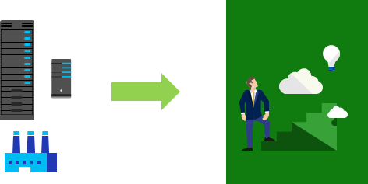
Consumption-based model
Users only pay for the resources they use
Notes:
The left-side graphic represents physical infrastructure, which is costly to acquire.
The arrow indicates a transition from physical infrastructure to the cloud, which has no physical infrastructure.
The user icon symbolizes migrating an idea from a person/ business to the cloud, and how users only consume the cloud resources they need.
Benefits to a consumption-based model include:
No upfront costs
No need to purchase and manage costly infrastructure that maybe under utilized
You only pay for additional resources as you need them
Stop paying for resources you no longer use

Slide 10
Lesson 03: Types of cloud models

Slide 11
Video: Cloud Models

Slide 12
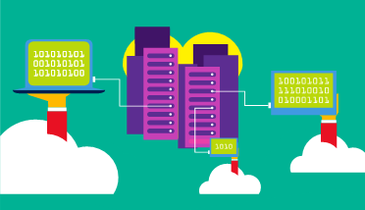
Public cloud
Owned by cloud services or hosting provider.
Provides resources and services to multiple organizations and users.
Accessed via secure network connection (typically over the internet).
Notes:
Public cloud models have the following characteristics:
Multiple end users. Public cloud models can make cloud resources available to multiple organizations.
Public access. The general public can have access to Public clouds.
Availability. Public cloud is the most common cloud deployment model.
Connectivity. Users and organizations typically connect to the Public cloud over the internet with a web browser.
Skills. Public clouds do not require deep technical knowledge to set up and use.
Example : Businesses can use multiple Public cloud service providers of varying scale. Microsoft Azure is an example of a public cloud provider.

Slide 13
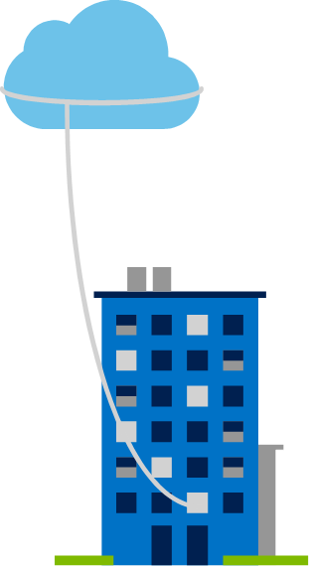
Private cloud
Owned and operated by the organization that uses cloud resources.
Organizations create a cloud environment in their data center.
Self-service access to compute resources provided to users within the organization.
Organizations responsible for operating the services they provide.
Notes:
Private cloud models have the following characteristics:
Ownership. The owner and user of the cloud services are the same.
Hardware. The owner is entirely responsible for purchasing, maintaining, and managing the cloud hardware.
Users. A private cloud operates within one organization only, and cloud computing resources are used exclusively by a single business or organization.
Connectivity. Connections to a private cloud are usually made over a highly secure, private network.
Public access. A private cloud does not provide access to the general public.
Skills. Deep technical knowledge is required to set up, manage, and maintain the private cloud.

Slide 14
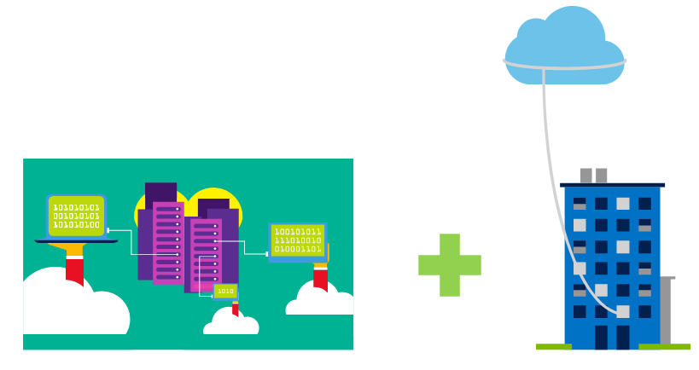
Hybrid cloud
Combines Public and Private clouds to allow applications to run in the most appropriate location.
Notes:
Hybrid cloud models have the following characteristics:
Resource location. Some resources run or are used in a Public cloud, while others run or are used in a Private cloud.
Cost and efficiency. Hybrid cloud models allow organizations to leverage the cost, efficiency, and scale benefits available with a public cloud model.
Control. Organizations retain management control in private clouds.
Skills. Technical skills are required to maintain the Private cloud component, and to keep Public and Private clouds operating together.
Example Hybrid cloud usage scenario: Hosting a website in the Public cloud and linking it to a secure database, hosted in a Private cloud.
Hybrid clouds are useful to organizations with information that cannot be put in a Public cloud, possibly for legal reasons. For example, some medical data cannot be exposed publicly.
You can read more about Microsoft Azure Hybrid cloud options at https://azure.microsoft.com/en-us/overview/hybrid-cloud/

Slide 15
Cloud model comparison
Public Cloud
No CapEx : Scale up without buying new infrastructure.
Agility : Access and de-provision applications quickly, as needed.
Consumption-based : Pay-per-use under an OpEx model.
Private Cloud
Control : Organization has full control of resources.
Security : Organization sets security policies.
Hybrid Cloud
Flexibility : Organization allocates applications to Private or Public clouds.
Compliance : Organization complies with security, operational or legal requirements as needed.
Notes:
This slide only contains some cloud model comparisons. Depending on time, broaden the discussion by seeking more detailed comparisons. Possible discussion points include:
Skills (Public cloud). No deep technical skills are required to deploy, use, and benefit from using a Public cloud. Organizations can leverage the skills and expertise of the cloud provider to keep workloads secure, safe, and highly available.
Skills. (Private cloud). By contrast, Private clouds require in-house IT skills and expertise that can be difficult or costly to acquire.
Specific scenarios. Public cloud services may not meet the needs of organizations with unique business requirements, such as maintaining legacy applications.
Costs. Purchasing and maintaining a Private cloud alongside a Public cloud (Hybrid) can cost more than using a single deployment model.

Slide 16
Lesson 04: Types of cloud services

Slide 17
Video: Types of Cloud Services

Slide 18
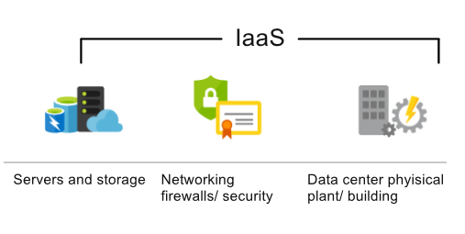
Infrastructure as a Service (IaaS)
Most basic cloud computing services category.
Build pay-as-you-go IT infrastructure by renting servers, virtual machines, storage, networks, and operating systems from a cloud provider.
Instant computing infrastructure, provisioned and managed over the internet.
Notes:
For more information on IaaS, visit https://azure.microsoft.com/en-us/overview/what-is-iaas/

Slide 19
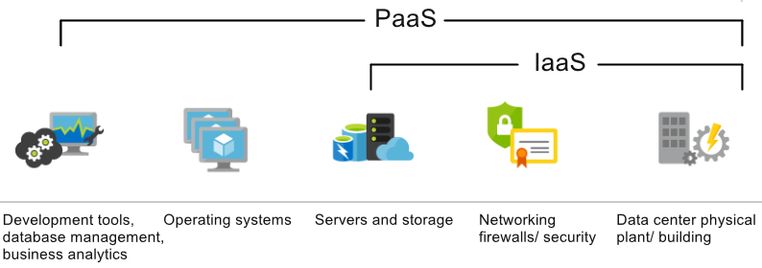
Platform as a Service (PaaS)
Provides environment for building, testing, and deploying software applications.
Helps create applications quickly, without focusing on managing underlying infrastructure.
Notes:
Common usage scenarios:
Development framework. PaaS provides a framework that developers can build upon to create or customize cloud-based applications. Similar to creating a Microsoft Excel macro, PaaS lets developers create applications using built-in software components. Cloud features such as scalability, high-availability, and multi-tenant capacity are included, which reduces the amount of coding for developers.
Analytics or business intelligence. Tools provided as services with PaaS allow organizations to mine and analyze their data. They can find insights and patterns, and predict outcomes to improve business decisions, such as forecasting, product design, and investment returns.
For more information on PaaS, see https://azure.microsoft.com/en-us/overview/what-is-paas/

Slide 20
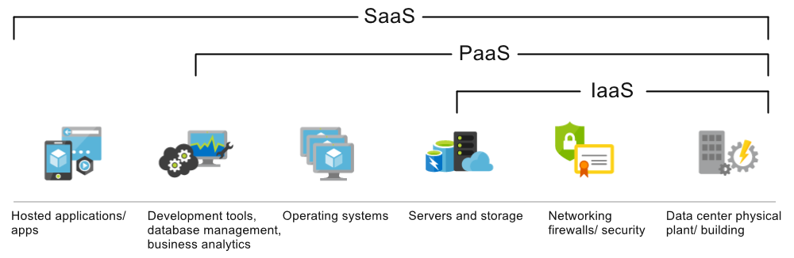
Software as a Service (SaaS)
Centrally hosted and managed software for end users. Users connect to and use cloud-based apps over the internet. For example, Microsoft Office 365, email, and calendars.
Notes:
Common usage scenarios:
Examples of Microsoft SaaS services include Microsoft Office 365, Skype, and Microsoft Dynamics CRM Online.
For more information on SaaS, see https://azure.microsoft.com/en-us/overview/what-is-saas/

Slide 21
Cloud service comparison
IaaS : Flexibility to control the configuration and management of hardware running your applications.
PaaS : Increases productivity as users focus on application development, and the cloud provider handles platform management. Platform is accessible via the internet which facilitates globally distributed teams.
SaaS : Pay-as-you-use pricing. Users pay for software they use with a monthly or yearly subscription.
Notes:
This slide contains only some cloud service comparisons. Depending on time, you may consider broadening the discussion using the points below.
IaaS : IaaS is the most flexible category of cloud services. It aims to give you complete control over the hardware that runs your applications. Instead of buying hardware, with IaaS, you rent it.
IaaS Advantages:
No CapEx. Users have no upfront costs.
Agility. Applications can be made accessible quickly, and de-provisioned as needed.
Skills. No deep technical skills are required to deploy, use, and benefit from using a public cloud. Organizations can leverage the skills and expertise of the cloud provider to ensure their workloads are secure, safe, and highly available.
PaaS : PaaS provides the same benefits and considerations as IaaS, with additional benefits.
PaaS Advantages:
No CapEx. Users have no upfront costs.
Agility. PaaS is more agile than IaaS, and users do not need to configure servers for running applications.
Productivity. Users focus strictly on application development, as all platform management is handled by the cloud provider. Working with distributed teams as services is easier, as the platform is accessed over the internet and available globally.
SaaS : SaaS provides the same benefits as IaaS, but with additional benefits.
SaaS Advantages:
No CapEx. Users don’t have upfront costs.
Agility. Users can provide staff with access to the latest software quickly and easily.
Pay-as-you-go pricing model. Users pay for the software they use with a subscription, monthly or yearly, regardless of how much they use the software.

Slide 22
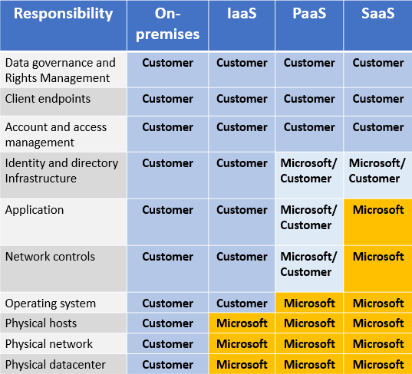
Management responsibilities
IaaS requires the most user management. User is responsible for managing operating systems, data, and applications.
PaaS requires less user management. Cloud provider manages operating systems. Users are responsible for the applications they run and data they store.
SaaS requires the least user management. Cloud provider is responsible for managing everything, the end user simply uses the software.
Notes:
It is important that users understand what they are responsible for, when using cloud services. This ensures their workloads are managed correctly and with minimal down time.
There’s a shared responsibility model for ensuring cloud workloads are secure and well-managed. Depending on the service you choose, the cloud provider is responsible for some aspects of workload management, and the customer/ end user is responsible for other aspects. In some cases these responsibilities are shared.

Slide 23
Lesson 05: Module review questions

Slide 24
Module 1 review questions
What are the benefits to using cloud services?
Which cloud model provides the greatest degree of flexibility?
You need to run two types of applications:
(a) legacy applications requiring specialized hardware
(b) newer applications running on commodity hardware
Which cloud deployment model is best for you?
Notes:
Answers
Question 1: Answers may vary, but correct answers include: elasticity, agility, and economies of scale.
Question 2: A Hybrid cloud model provides greater flexibility, because it includes the option to choose Public or Private clouds, or both, depending on your requirements.
Question 3: With a Hybrid cloud model you can (a) run legacy applications that require customized/ specialized configurations and direct management on a Private cloud, while (b) running modern applications on a Public cloud.

